Slide 1
Breast Cancer Detection using Gold Nanoparticles & AI
Hands-on Project using Python + SQL
Vaishnavi Bandewar

Slide 2
Objective
- To demonstrate how AI can be applied to biomedical concepts.
- Explore the potential of Gold Nanoparticles for Breast Cancer treatment.
- Use SQL for dataset storage and Python for Machine Learning.
- Show hands-on coding with Random Forest model.

Slide 3
Methodology Workflow
1. Created dummy dataset with variables: Size, Dose, Cell Death %.
2. Stored dataset in SQL database and performed queries.
3. Imported dataset into Python (Google Colab).
4. Trained Random Forest Classifier using scikit-learn.
5. Evaluated model with Confusion Matrix and Classification Report.

Slide 4
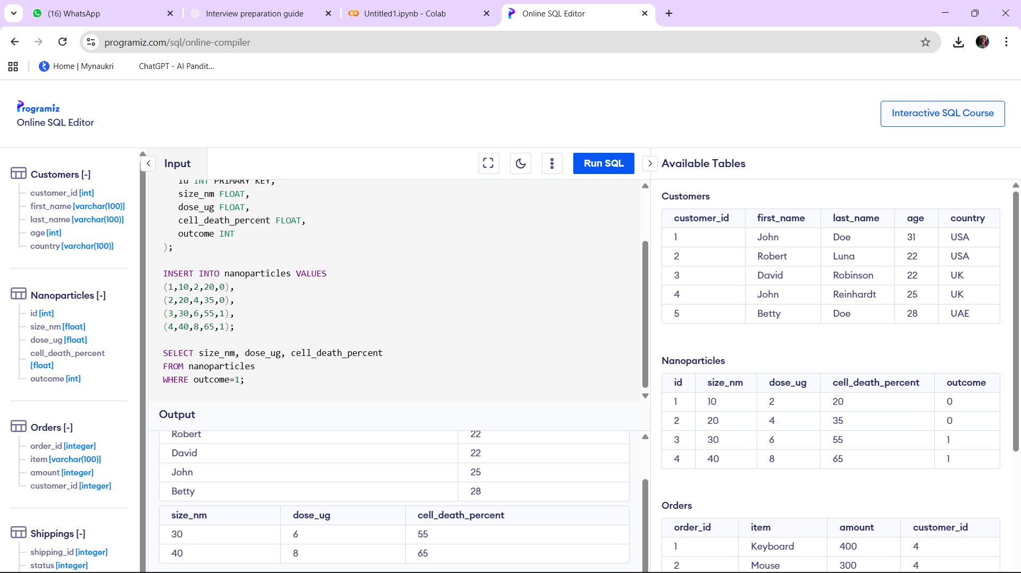
SQL Implementation (Proof)

Slide 5
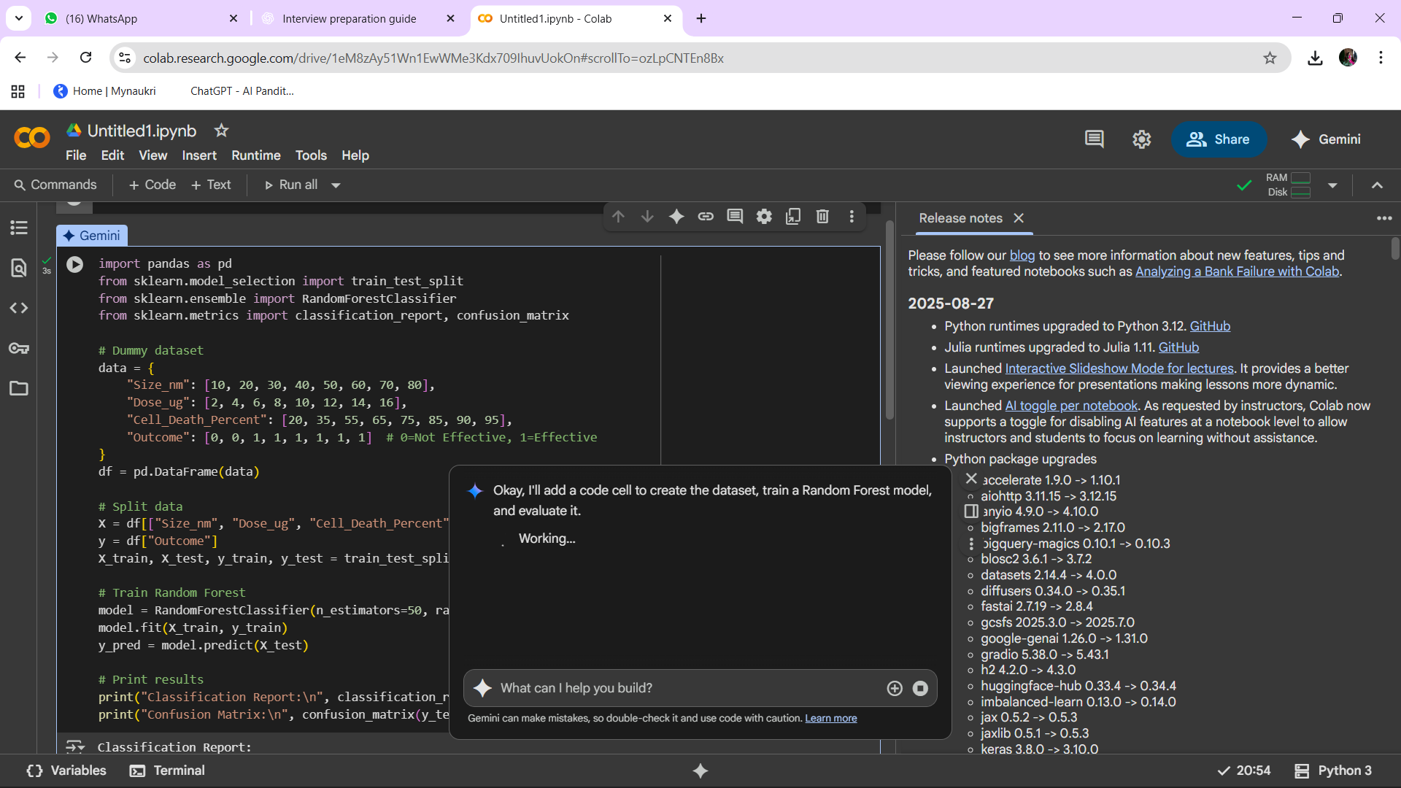
Python Implementation (Proof)

Slide 6
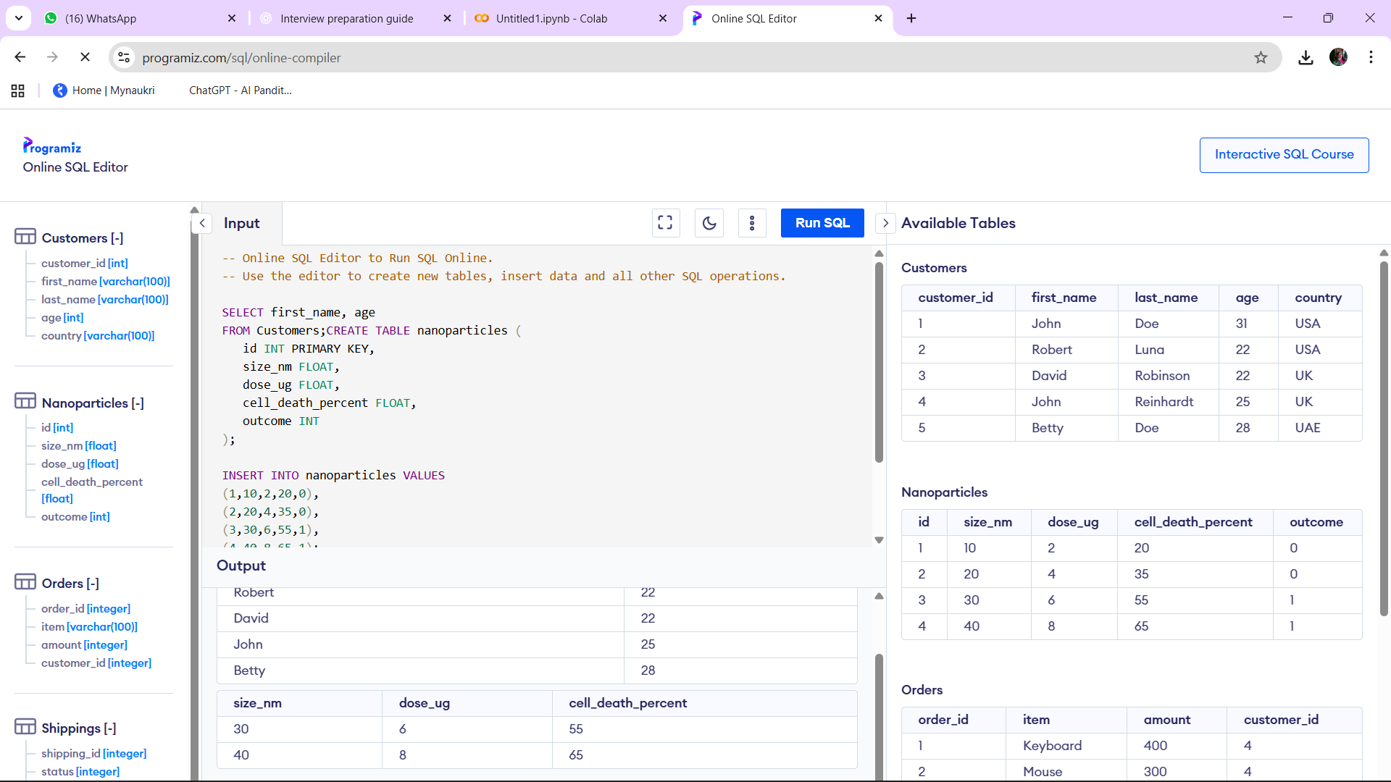
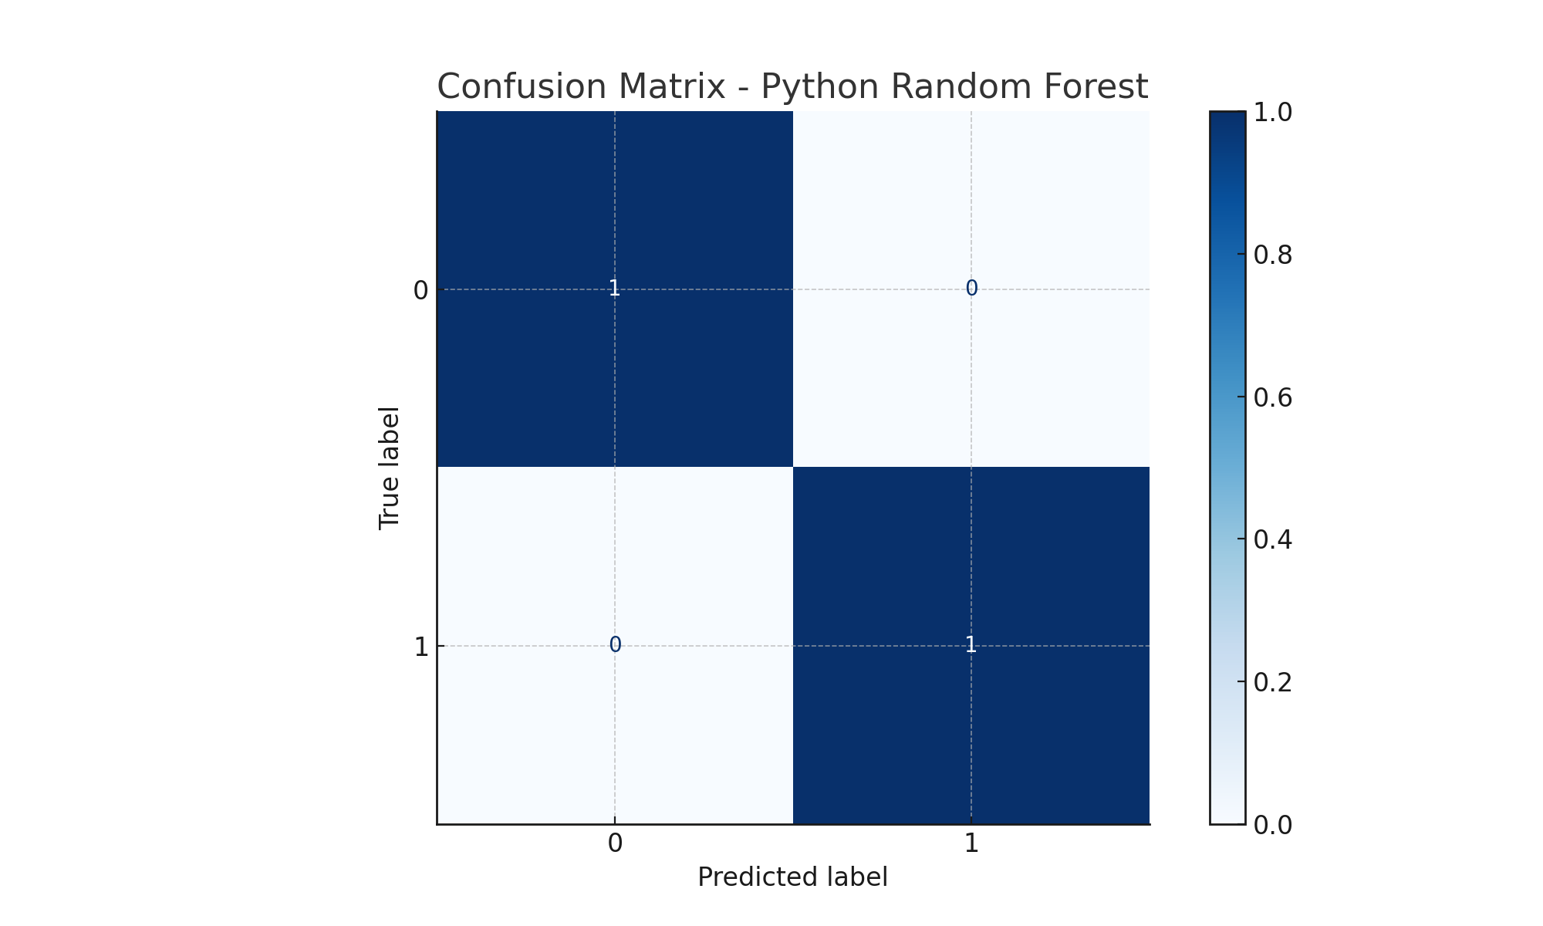
Results (Proof of Execution)

Slide 7
Vision & Application
- AI can help in biomedical research by predicting outcomes before lab testing.
- SQL ensures structured data storage, reducing errors.
- Python ML models provide fast predictions and insights.
- Such integration can reduce cost, save time, and support CRA/clinical research roles.
- My vision: Apply AI practically in Clinical Research at Trialguna.

